Slide 1

Recruitment Process
Team SAKura

Slide 2
About Sakura
Switzerland based small-sized consulting company
Specialized in providing digital solution
Clients include: banking, pharma and construction companies

Slide 3
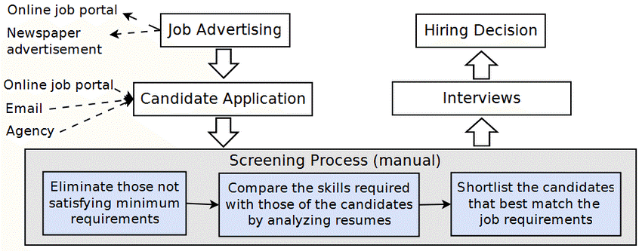
As-Is Process
As-Is Process Partners
Networking
Job sites
External resourcing consultancies
News papers

Slide 4
Challenges
Human-intensive process
No real-time overview on the whole process
Inefficient talent sourcing in regards of total time taken and costs incurred
Building talent pools proactively
Less competitive
Lack of suitable workforce for future development plans

Slide 5
To-Be Process Flow
Process Flow Screen shot and explanation video

Slide 6
Process Capability
Generate candidates score based on skill-sets therefore able to recruit high-skilled employees
Quick and efficient shortlisting of candidates
Real-time recruitment process overview
Easy to maintain talent pool
Prioritize queue
Digitalization of recruitment process saves time and cost

Slide 7

Conversational Chatbot
Personalised experience to the candidate
Interactively collecting basic candidate information
Eliminates human intervention
Leaving positive impression on the candidate

Slide 8
Recommendation
Further enhancement of recruitment process using robotic process automation and data mining
Interview scheduling by chatbot
Chatbot to interact with the applicant during the recruitment process

Slide 9
Conclusion
Rationalize the recruitment process
Reduces time to hire
Eliminates manual intervention and mistakes
Better candidate experience
Focus on value added task
Internal talent pool
Paper less execution of process …Go Green

